Slide 1
COMMUNICATION
A TECHICAL PERSPECTIVE

Slide 2
What is Communication?
Communication is the process of conveying information in such a way that the message is received and understood by the receiver as intended by the sender.
Communication is any behavior, verbal or non-verbal, that is perceived by another. Knowledge, feelings, or thoughts are encoded and sent from a source and received and decoded by another. A connection is made between the people communicating.

Slide 3
Essential Qualities of Good Communicators
Empathy
Awareness and Concern for Others
Good Listening Ability
Self-Knowledge (needs, concerns, strengths, weaknesses)
Open, Approachable, Supportive

Slide 4
Communication in Academics and the Workplace
Academic Purposes
1. To prove one’s eligibility
2. To demonstrate expertise in research
3. For project defense
4. Academic Presentations
5. Course Writing Assignments
6. Letters and Emails
Business Purposes
1. To instruct
2. To direct
3. To inform
4. To persuade
5. To evaluate
6. To motivate

Slide 5
Academic Audience
Instructors
Teachers
Examiners
Administrative Staff
Students
Other professionals and academicians

Slide 6
Workplace Audience
Executives
Managers
Peers
Subordinates
Customers/Clients
Supervisors
Vendors
Governmental Officials
Other Organizations
Professional Networks

Slide 7


Forms of Communication
What’s common between the following?

Slide 8
Forms of Communication
VERBAL COMMUNICATION: Verbal form can either be spoken or written. It involves the use of words.
Examples:
1. Presentation
2. Speech
3. Meeting
4. Research paper
5. Blog

Slide 9


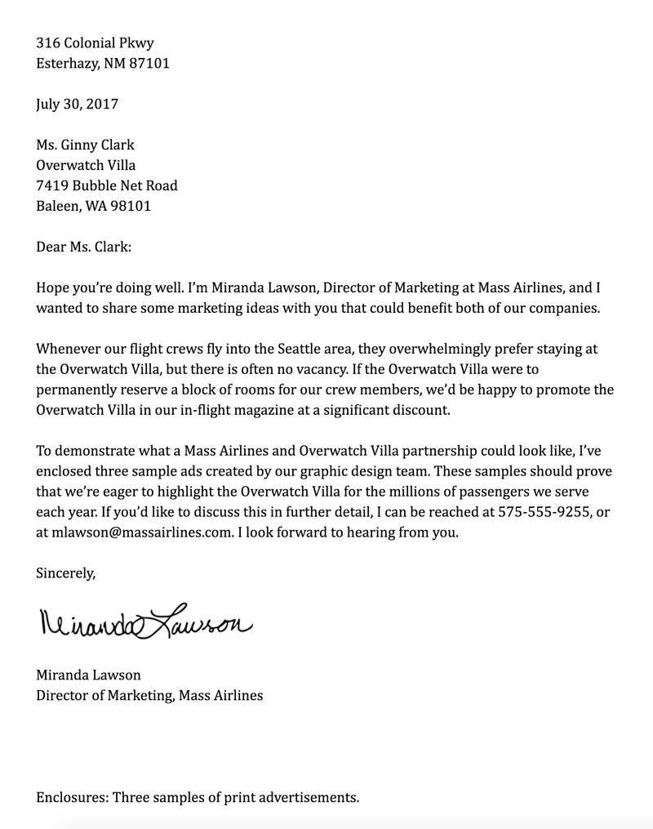
Forms of Communication
What is common between the following?

Slide 10
Forms of Communication
NON-VERBAL COMMUNICATION: In this form, words or graphics are not employed. It is present in written, oral, and graphic communication.
It involves the use of
Body language
Paralanguage
Dressing/accessories in speech
Colors
Architecture
On the other hand, format, layout, handwriting style, etc. are non-verbal elements in writing.

Slide 11
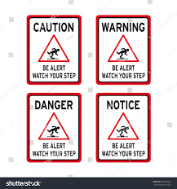
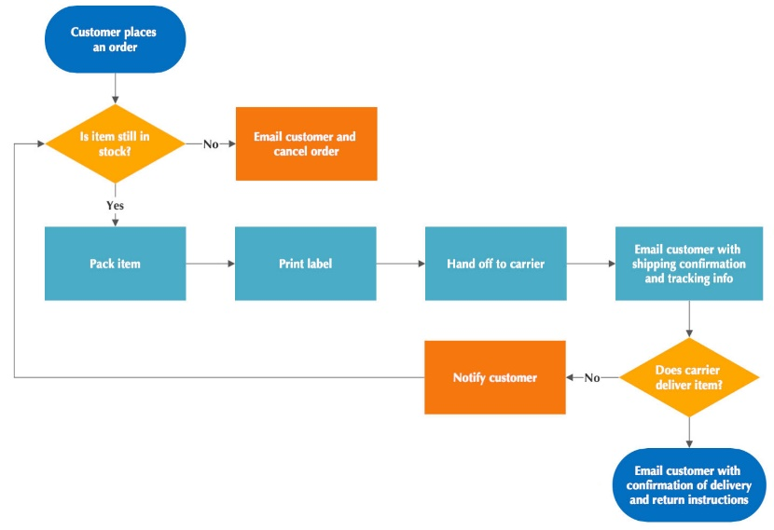
Forms of Communication

Slide 12
Forms of Communication
GRAPHIC COMMUNICTION: It represents ideas, feelings, views, etc. visually by the use of shapes, diagrams, lines, symbols, illustrations, color, etc. It can have both verbal and non-verbal elements.

Slide 13
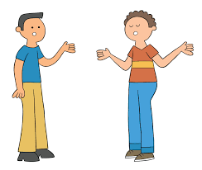
Types of Communication
INTERPERSONAL: It involves interaction between people on a one-to-one basis or in small groups.

Slide 14

Types of Communication
INTRAPERSONAL: It refers to communication within an individual through the process of thinking and feeling. It enables you to communicate with yourself. This style of communication creates a person’s self-concept and process information. Take the time to think, plan, and interpret ideas and messages. Also, give yourself time to absorb new ideas and plan your actions.

Slide 15

Types of Communication
TELEPHONIC COMMUNICATION: It uses a telephonic or any other advanced medium for communication between participants. It includes aural transfer.

Slide 16

Types of Communication
PUBLIC COMMUNICATION (from the point of view of business): It originates from one source or an organization and targets members within or outside the organization. It involves informing and persuading the members of an audience to hold certain attitudes, values, or beliefs, so that they will think, believe, or act in a particular way; on the other hand, you can also function as a member of an audience, in which case another person will do the same for you.

Slide 17

Types of Communication
MASS COMMUNICATION: Mass communication is communication between mass media (electronic and print) and the public.

Slide 18

Types of Communication
ELECTRONIC COMMUNICATION: Electronic communication can be defined as, the communication which uses electronic media to transmit the information or message using computers, e-mail, telephone, video calling, FAX machine, etc.

